Slide 1
BUS 101
Environment of Business
Chapter 5

Slide 2
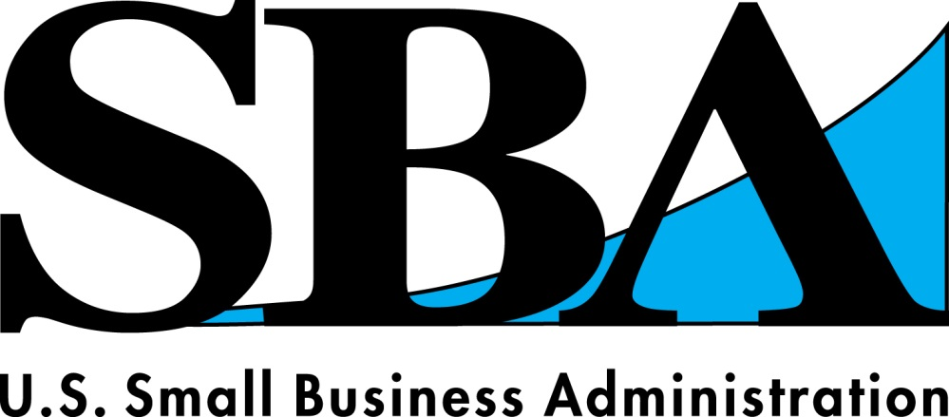
Small Business Administration(SBA)
Definition: a federal government agency
concerned with helping small U.S. firms (pg157)
What do they do?
Give Advice
Secure Government Contracts
Provide Training
Guarantees small-business loans made by private lenders
Fun Fact: SBA’s Washington
Headquarters have more than 2.100
Employees on Staff

Slide 3
Question #1 How is a small business defined by the Small business association?
Definition: an “independent business having fewer than 500 employees” (pg147)
Although a small business is defined by the SBA as having fewer than 500 employees, this varies based on the industry
Example: Small Manufacturers may have around 500 workers, while wholesalers must employ fewer than 100

Slide 4
Why do we care?
Small Businesses account for 98% of U.S. firms
Small Businesses are eligible for government….
Loans
Purchasing Programs
…which allow for small businesses to expand and grow larger

Slide 5
What is the Small business association?
How is a small business defined by the Small business association?
Decide which of the following fall under the criteria of a small business and explain why you think that is (hint: use your textbook if you get stuck!).
Hospitals
Goodyear
Nike
Cost Cutters
Apple
Why do we care?
Small Businesses account for 98% of U.S. firms
Small Businesses are eligible for government loans and purchasing Programs which allow for small businesses to expand and grow larger

Slide 6
Works Cited
"Kansas Small Business Development Center." KSBDC: Growing Kansas Entrepreneurs. N.p., n.d. Web. 10 Oct. 2013.
"Small Business Center." Small Business Center. N.p., n.d. Web. 10 Oct. 2013.
"Small Business Forum | Brooklyn Community Board 14." Brooklyn Community Board 14 RSS. N.p., n.d. Web. 10 Oct. 2013.
"Yes You Can Obtain Fast Military Loans Even With Poor Credit." Just Military Loans RSS. N.p., n.d. Web. 10 Oct. 2013.

